Slide 1
Energy consumption
forecasting project
PRESENTATION
Advanced Time Series
Melnichenko Mikhail
worldmansist/German-energy-Time-Series-analysis-: Project for opencampus course Advanced Time Series Prediction

Slide 2
Key data features
Extreme value theory
Correlations
Feature 1
Feature 2
Feature 3
15-minutes time intervals for 187299 total observations
From
2019-12-31 -23:00:00
till
2025-05-04-22:00:00
15 variables from which 2 were combined and 1 deleted, 13 in total
“Windoffshore” + “Windonshore”=“Wind”
“Nuclear” was deleted
187195 observations left after the missing data was deleted
0,0534% for Load column
4,9656% for Solar column
Feature 4
Small number of extreme values and anomalies

Slide 3
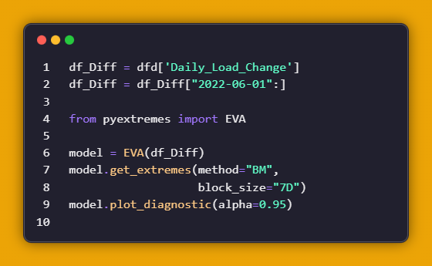
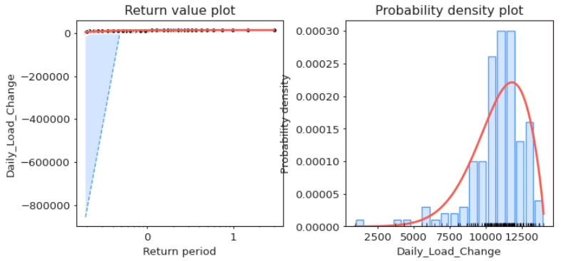
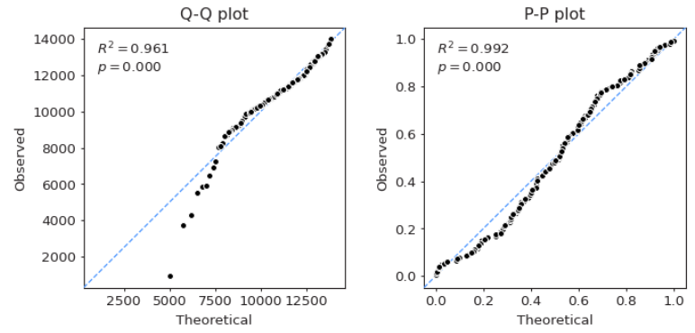
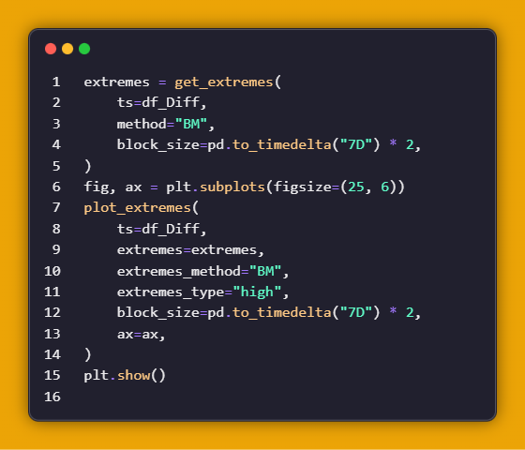
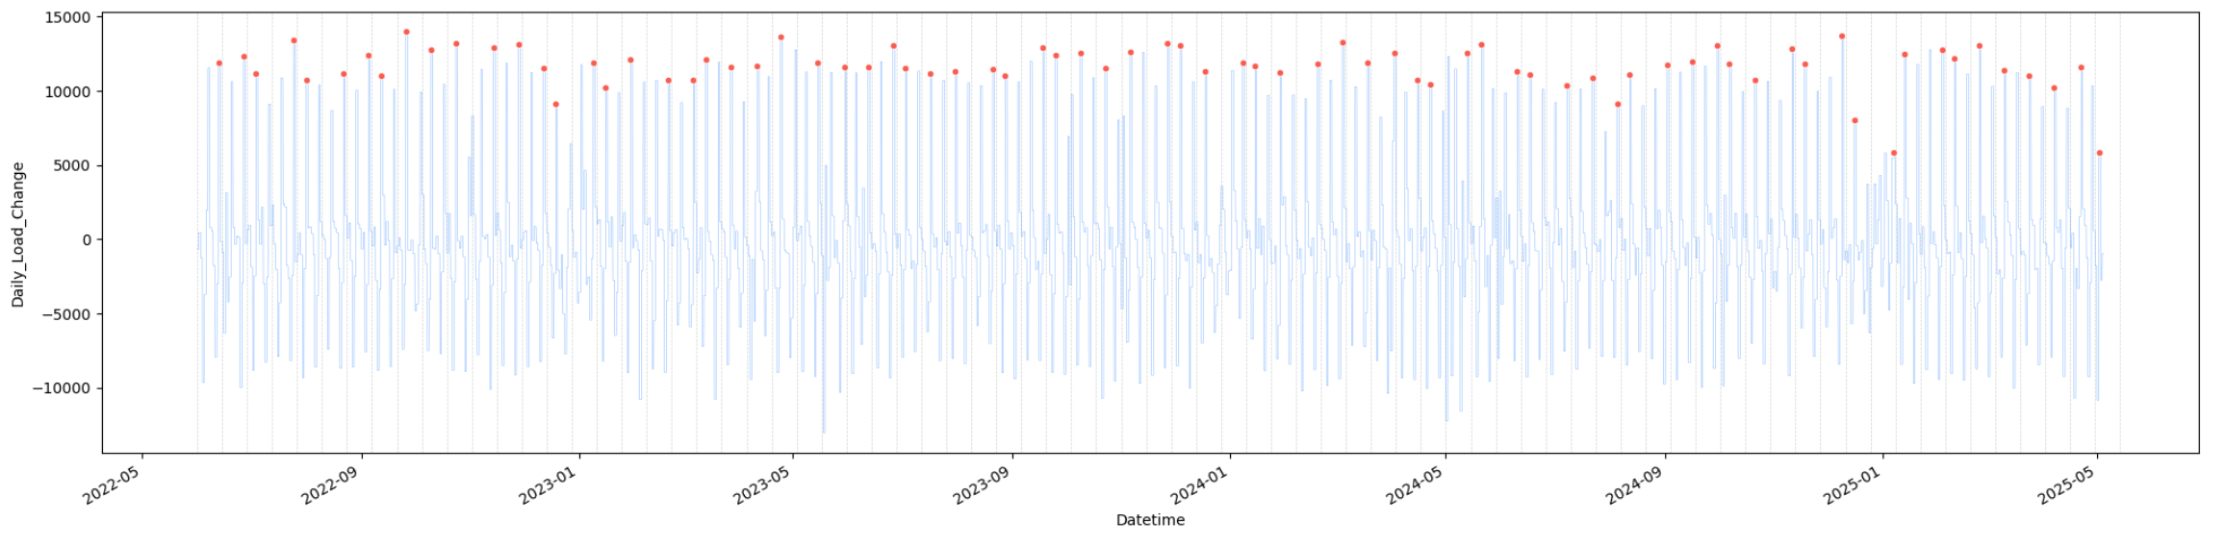
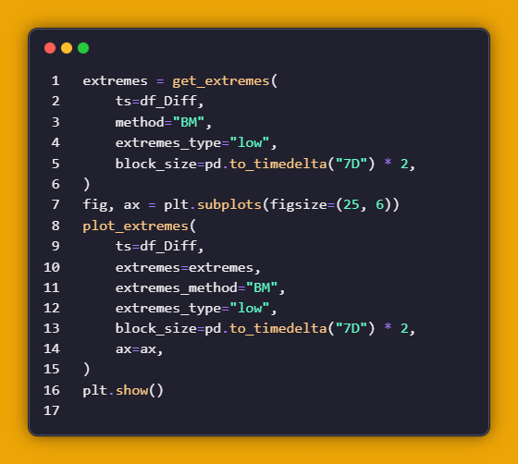
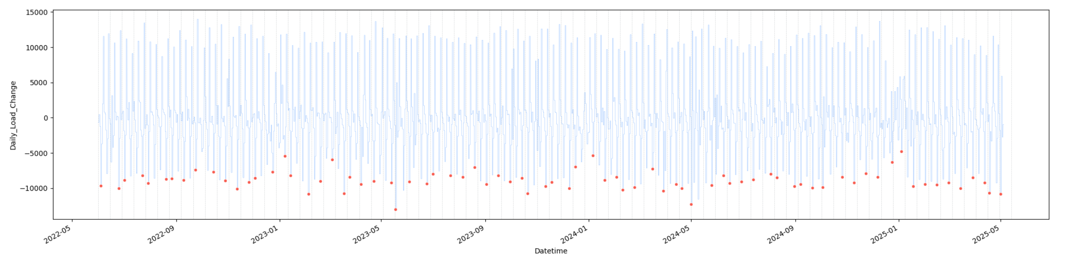
Key data features
Extreme value theory
Correlations

Slide 4
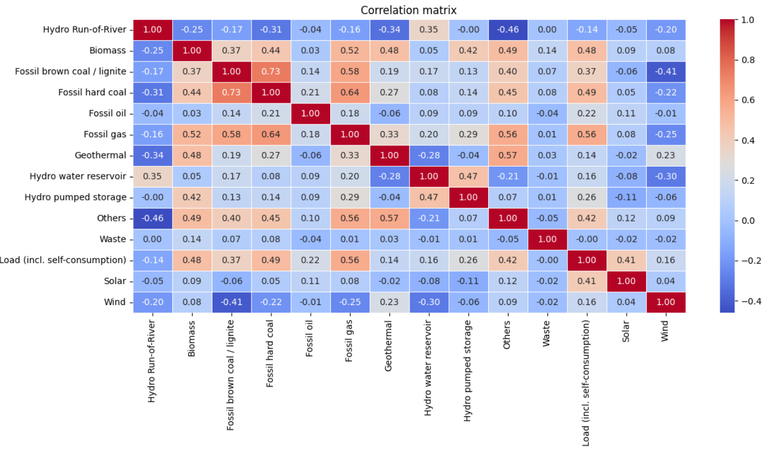
Key data features
Extreme value theory
Correlations
Correlation
Insight 1
01
A few strong correlated features
Insight 2
02
“Other” category is quite important, could be some unobservable data there like temperature or holidays.
Insight 3
03
Some correlations are negative, means that these features replace each other

Slide 5
01
02
03
Deep learning models
Base models
Conclusion
XGBoost, LightGBM, CatBoost
RNN, LSTM, GRU.
Results and future improvements

Slide 6
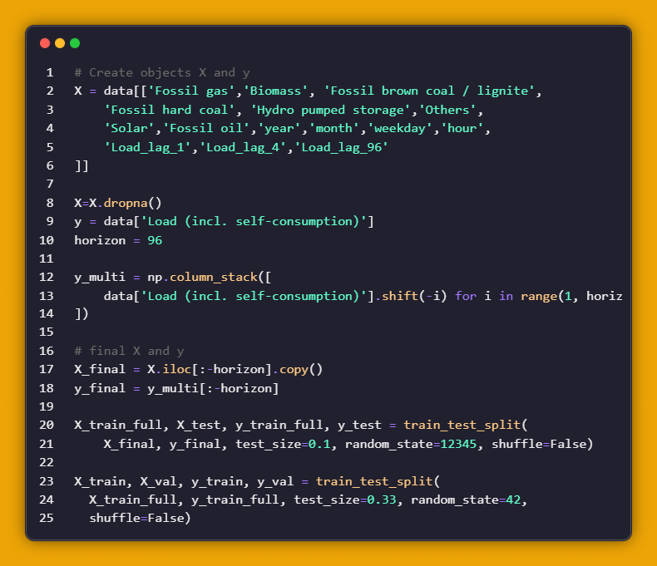
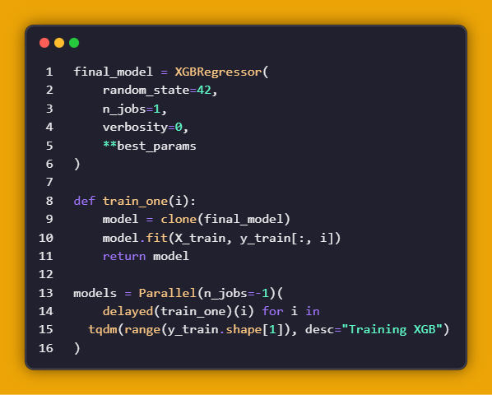
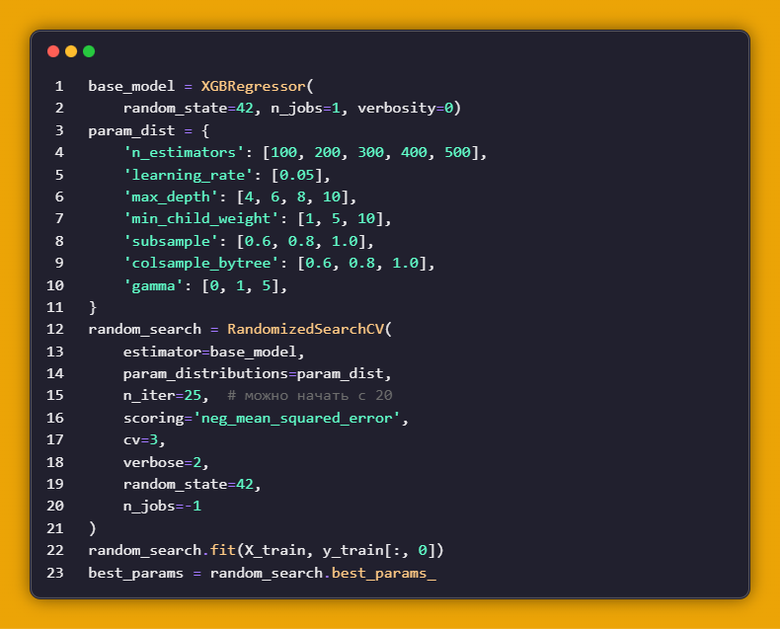
Base models
Deep learning models
Results
Full data preprocessing
Random Search
Best parameter model

Slide 7
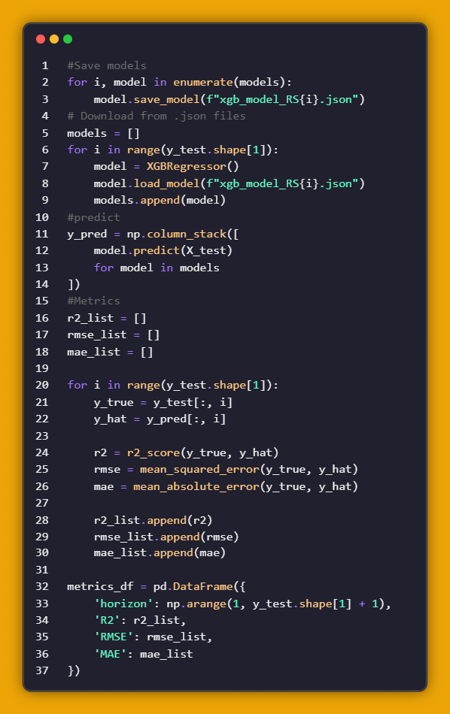
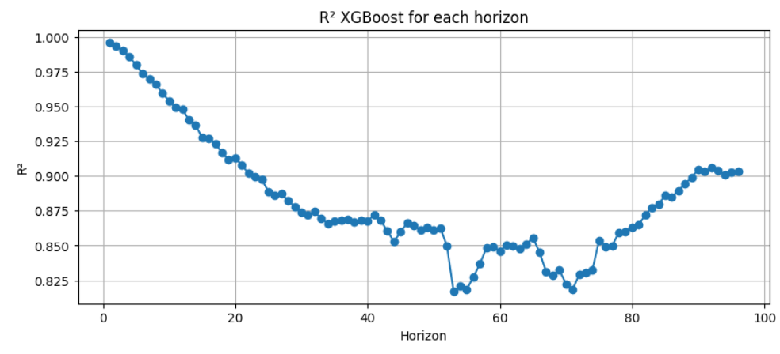
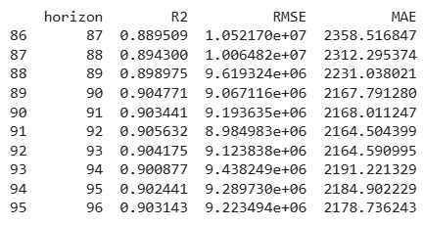
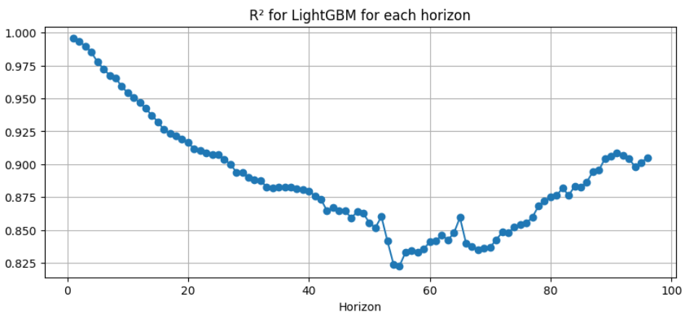
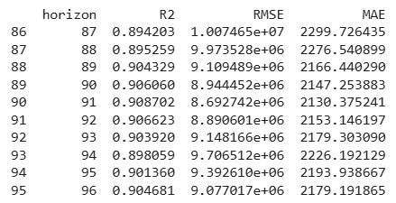
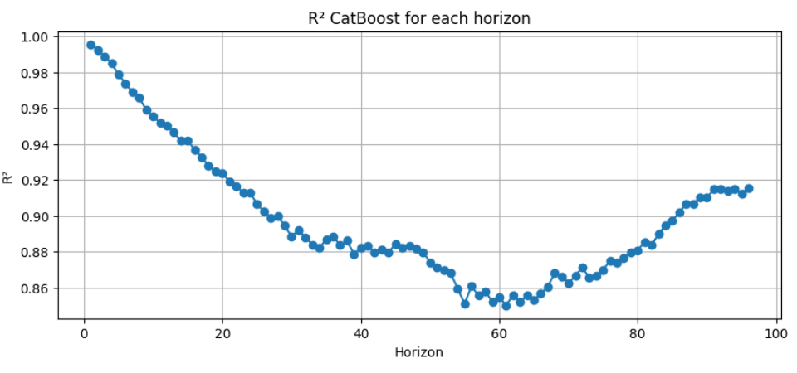
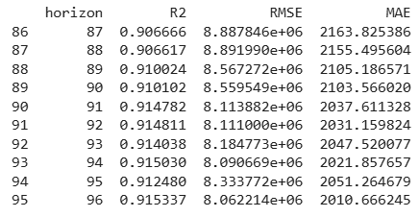
Base models
Deep learning models
Results

Slide 8
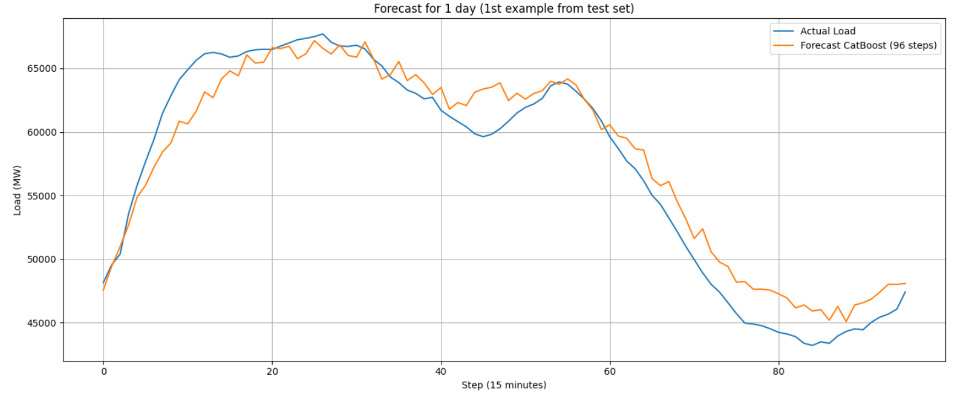
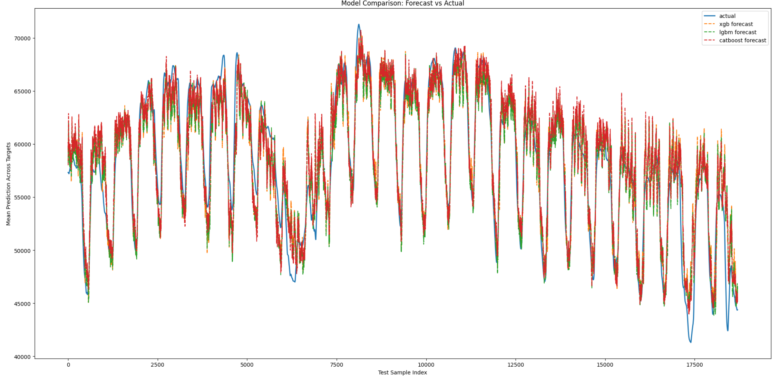
Base models
Deep learning models
Results

Slide 9
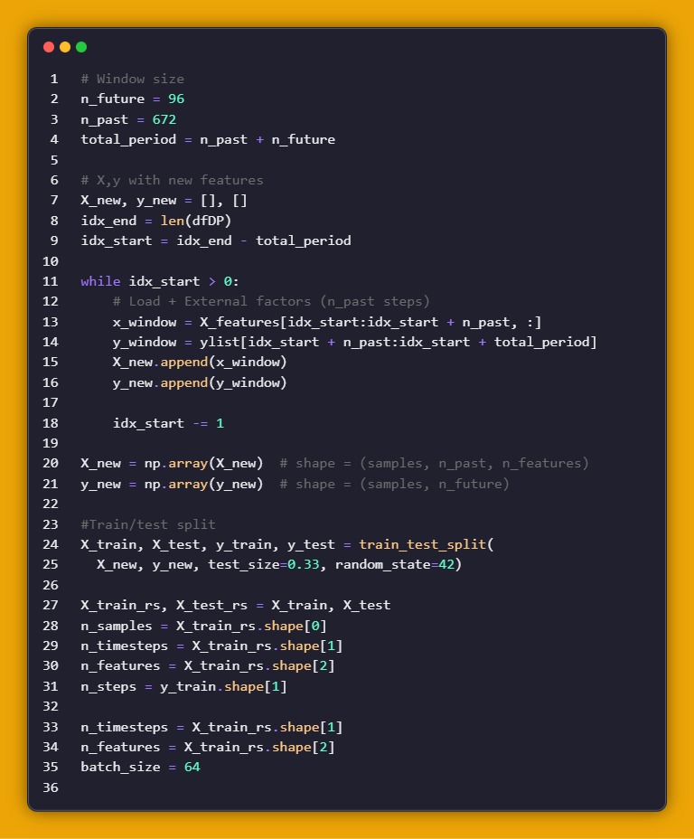
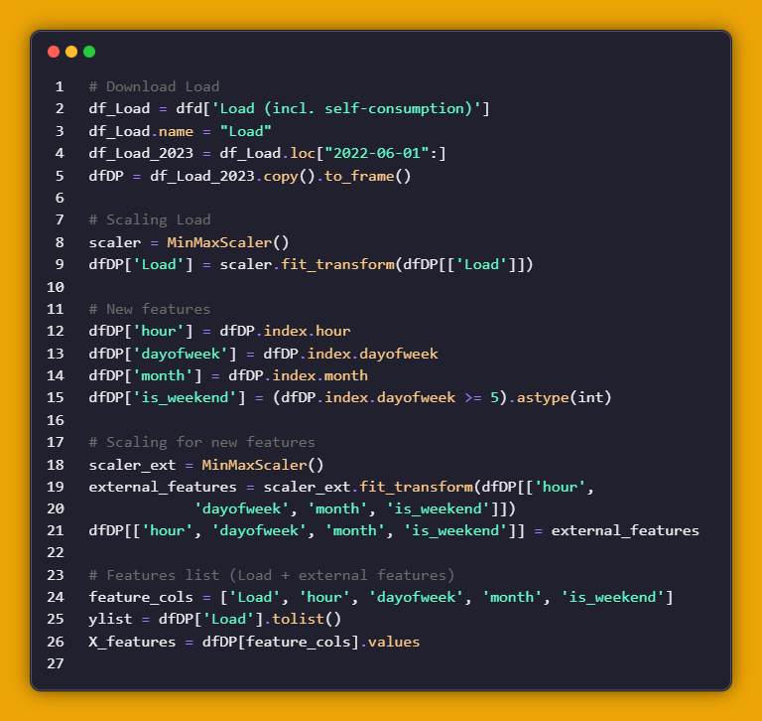
Base models
Deep learning models
Conclusion
Target variable MinMax Scaling
“New features: hour, dayofweek, month, is_weekend.
New features MinMax Scaling
Multiple sliding windows of length 672 are created, and for each window, a forecast for the next 96 steps is generated.
The whole historical data is split into training examples.
The resulting samples are fed into RNN, GRU and LSTM models.

Slide 10
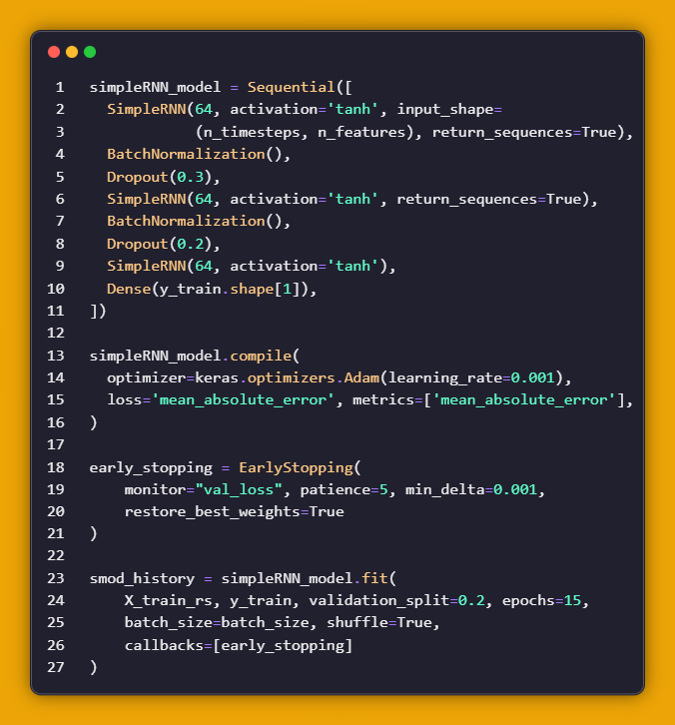
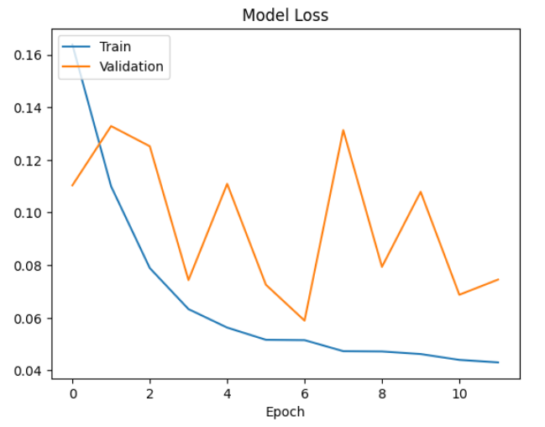
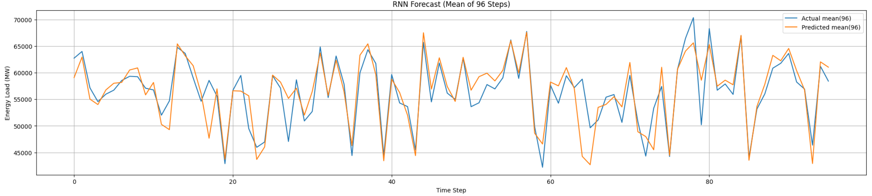
Base models
Deep learning models
Conclusion
R^2 | 0.7984
MAE | 0.0582
RMSE | 0.0847
💩
01
Not so well results in comparison with baseline models
03
Model is still fine to predict most of the tendencies
02
On the model loss graph can be seen the overfitting situation

Slide 11
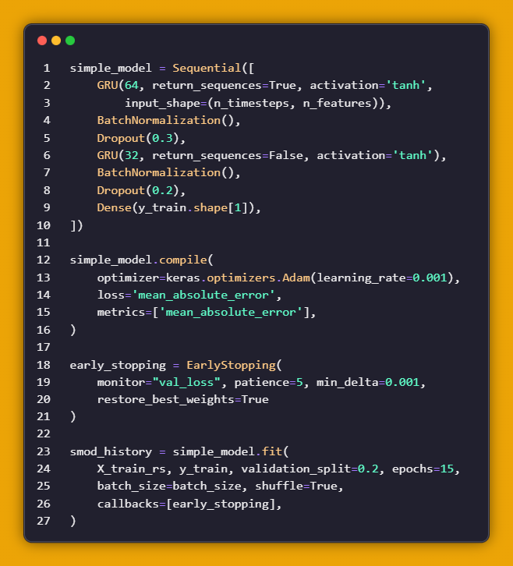
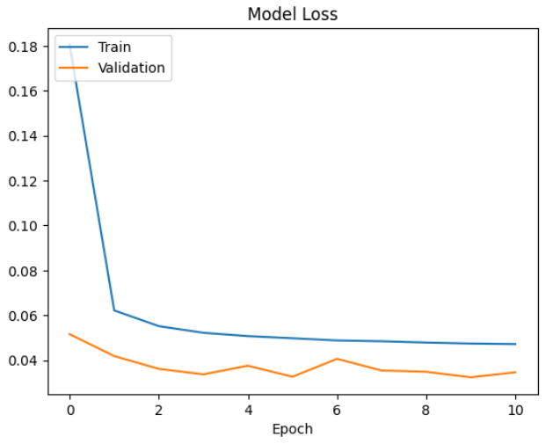

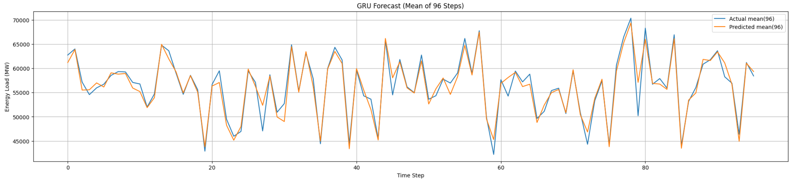
Base models
Deep learning models
Conclusion
R^2 | 0.9407
MAE | 0.0326
RMSE | 0.0459
01
Very good metric’s values
02
Well trained model with stable validation results.

Slide 12
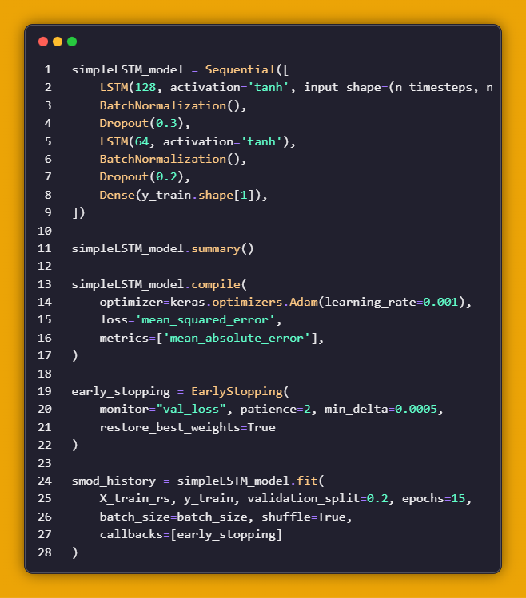
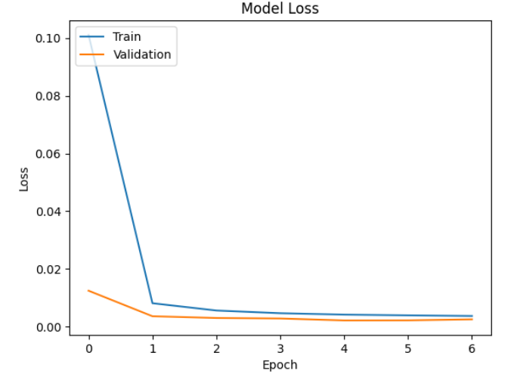
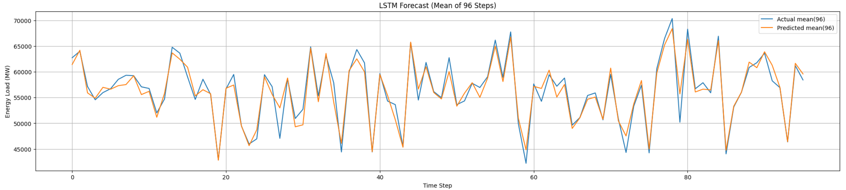
Base models
Deep learning models
Conclusion
R^2 | 0.9390
MAE | 0.0333
RMSE | 0.0466
01
Very good metric’s values
03
Only 6% of variance is not explained by the model.
02
Well trained model with stable validation results.
04
Slightly worse than GRU model, but needs more time to train. Maybe should use other features.

Slide 13




Base models
Deep learning models
Conclusion
Current problems and Future Changes
Not enough computer power for Random Search in Deep Learning models to find best hyperparameters
Try new more powerful models for long-time predictions like Transformers.
Differences in applied packages between Collab and Jupiter notebooks
Try to find good features which are not about energy source like holiday, temperature, region and others.

Slide 14

Thank You
FOR YOUR TIME
Advanced Time Series
Melnichenko Mikhail
Fauget Inc.
worldmansist/German-energy-Time-Series-analysis-: Project for opencampus course Advanced Time Series Prediction

